Slide 1
Name:P.Pavithran
3rd year B.E.CSE
NM ID:au421221104025
Email id:pavithranprabaharan2003@gmail.com
3/21/2024 Annual Review

Slide 2
Animal species identification from images

Slide 3


AGENDA
Problem Statement
Project Overview
Who Are The End Users?
Your Solution And Its ValueProposition
The Wow In Your Solution
Modelling
Results
3/21/2024 Annual Review

Slide 4

PROBLEM STATEMENT
The problem is to build a system that can accurately identify animal species from images, involving collecting data, labeling images, developing a model, evaluating its performance, deploying it for real-world use, and continuously improving it over time.
3/21/2024 Annual Review

Slide 5

PROJECT OVERVIEW
An animal species identification project involves using computer vision techniques to analyze images and classify them into different species categories.
This typically involves training a machine learning model on a dataset of labeled images, then deploying the model to classify new images.
The goal is to create a system that can accurately identify various species of animals from images.
3/21/2024 Annual Review

Slide 6

WHO ARE THE END USERS?
The end users of animal species identification from images could include researchers, wildlife enthusiasts, conservationists, veterinarians, and anyone interested in wildlife photography or ecology.
3/21/2024 Annual Review

Slide 7

YOUR SOLUTION AND ITS VALUE PROPOSITION
Our solution utilizes advanced image recognition algorithms to accurately identify animal species from images.
Its value proposition lies in its ability to provide quick and reliable species identification, aiding researchers, conservationists, and wildlife enthusiasts in their efforts to study and protect wildlife populations.
3/21/2024 Annual Review

Slide 8

THE WOW IN YOUR SOLUTION
The "wow" factor in our solution is its ability to accurately identify animal species from images with impressive speed and precision.
It harnesses cutting-edge technology to deliver near-instantaneous results, empowering users with a powerful tool for wildlife research, conservation, and education.
3/21/2024 Annual Review

Slide 9
MODELLING
Teams cam add wireframes
Animal species identification from images involves creating a model that can analyze images and classify them into different animal species.
This typically involves using deep learning techniques, such as convolutional neural networks (CNNs), trained on large datasets of labeled animal images.
The model learns to recognize features unique to each species and makes predictions based on those features.
3/21/2024 Annual Review

Slide 10
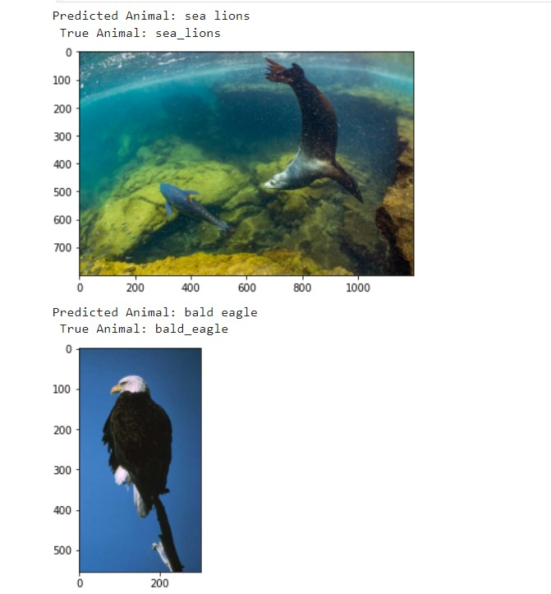
RESULTS
Identifying animals from images usually involves using computer vision algorithms that analyze features like shapes, patterns, and colors to match them with known species.
Demo Link
3/21/2024 Annual Review

